Slide 1
St. Nicholas Day in the WB
By Tymek Mikrut and Ksawery Hudzik

Slide 2
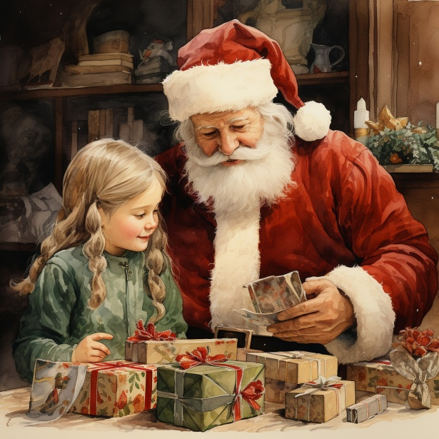
Santa Claus (or Father Christmas) does not visit the well-behaved little Brits on the 6th of December, but on the night of the 24th to the 25th of December. On Christmas Eve, children hang special Christmas stockings on the hood of the fireplace - or elsewhere - and go to sleep. At night, Santa Claus fills his socks with gifts. He gets into the house through the chimney

Slide 3
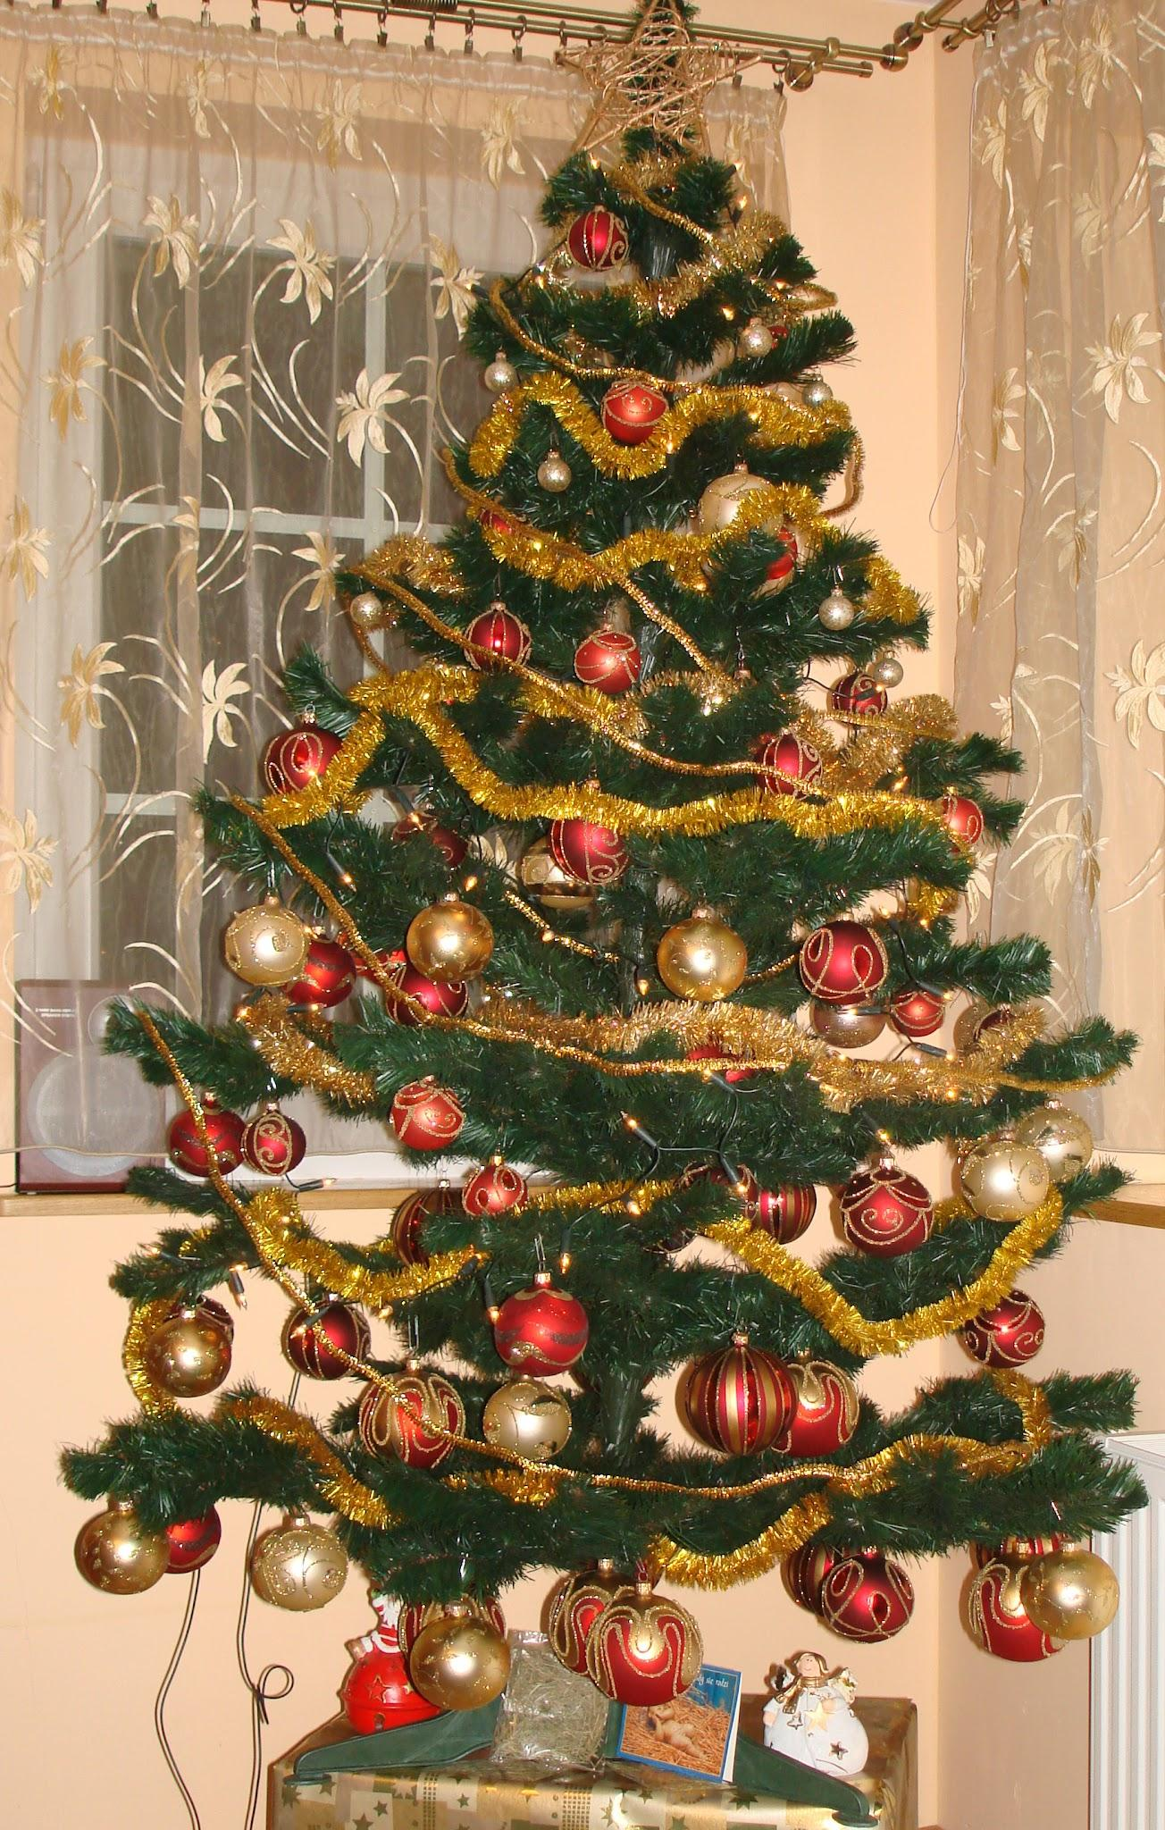
Customs of St. Nicholas Day
In medieval Western Europe, Saint Nicholas was considered the patron saint of children. In some towns, sources record the custom of electing a child bishop on St. Nicholas Day, who symbolically took over power. In the 16th century, the British Isles had a ritual of taking the headmaster out of school on this day and taking over the power by the students. It has survived for several centuries in some regions

Slide 4
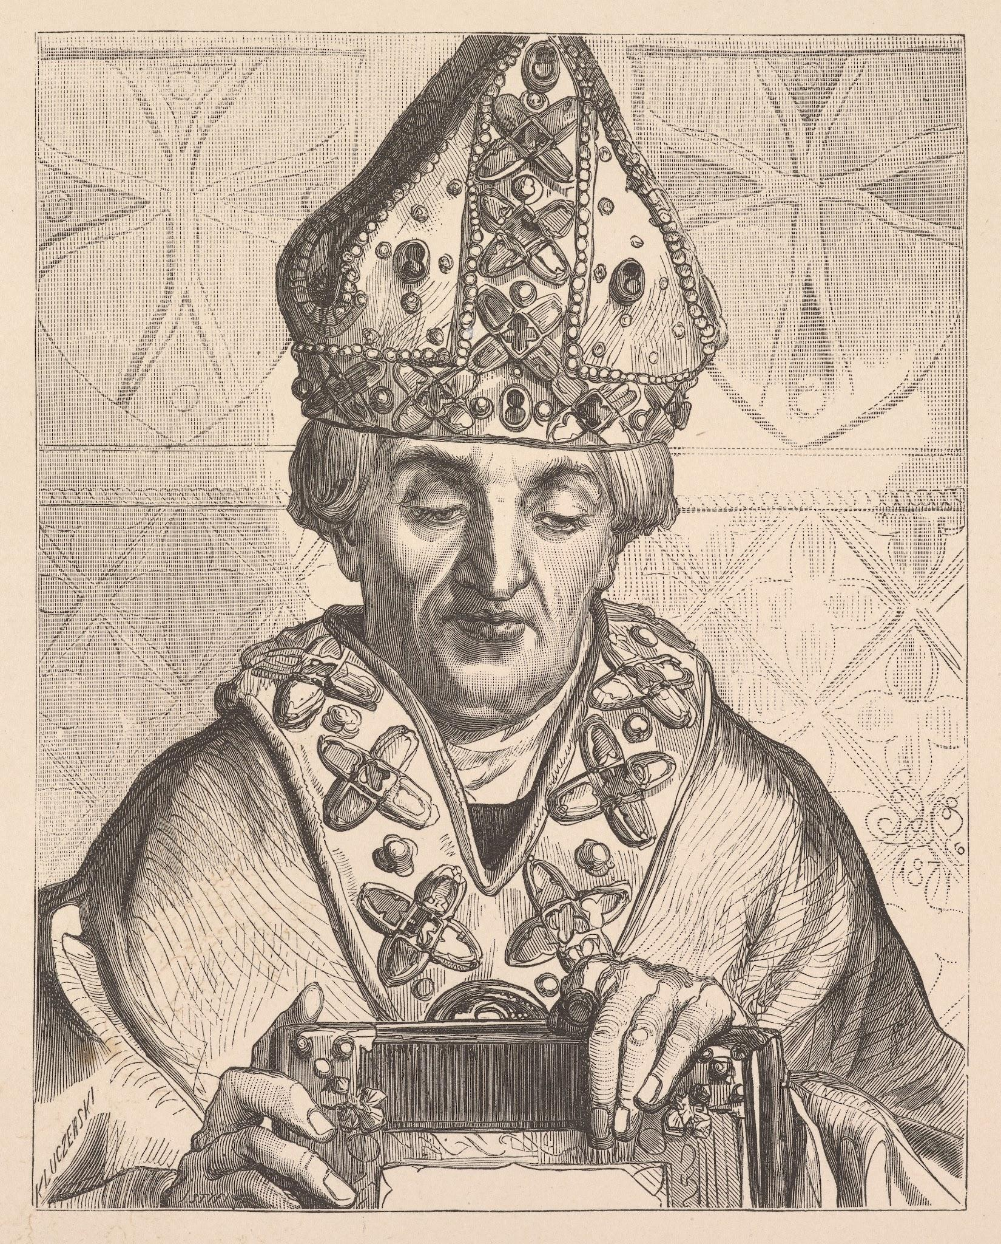
St. Nicholas of Mithras
Nicholas of Myra (Greek: Άγιος Νικόλαος, Latin: Sanctus Nicolaus), also known as Nicholas of Bari, was a Roman Catholic and Orthodox saint. The oldest records about him date back to the 6th century. According to medieval hagiography, he lived at the turn of the 3rd and 4th centuries (legendary accounts claim that he was born around the year 270 and died on December 6 between the years 345 and 352), was the bishop of Myra in Lycia, and became famous for miracles and helping the poor and needy.

Slide 5
Dear Santa,
My name is Kasia, and I am ten years old. I live in England. I’m so excited for Christmas and your visit!
This year, I have been good all the time. What I would like most this Christmas is lego car and sweets.
I promise to leave you milk and cookies on Christmas Eve! Thank you, Santa!
Love,
Kasia

Slide 6
Thank You For Wathing
Merry Santa Claus

